Slide 1
RF Lab – Experiments with SDRs
Alphan Şahin
Wireless Channel

Slide 2
Task 1 - Multipath Channel

Slide 3
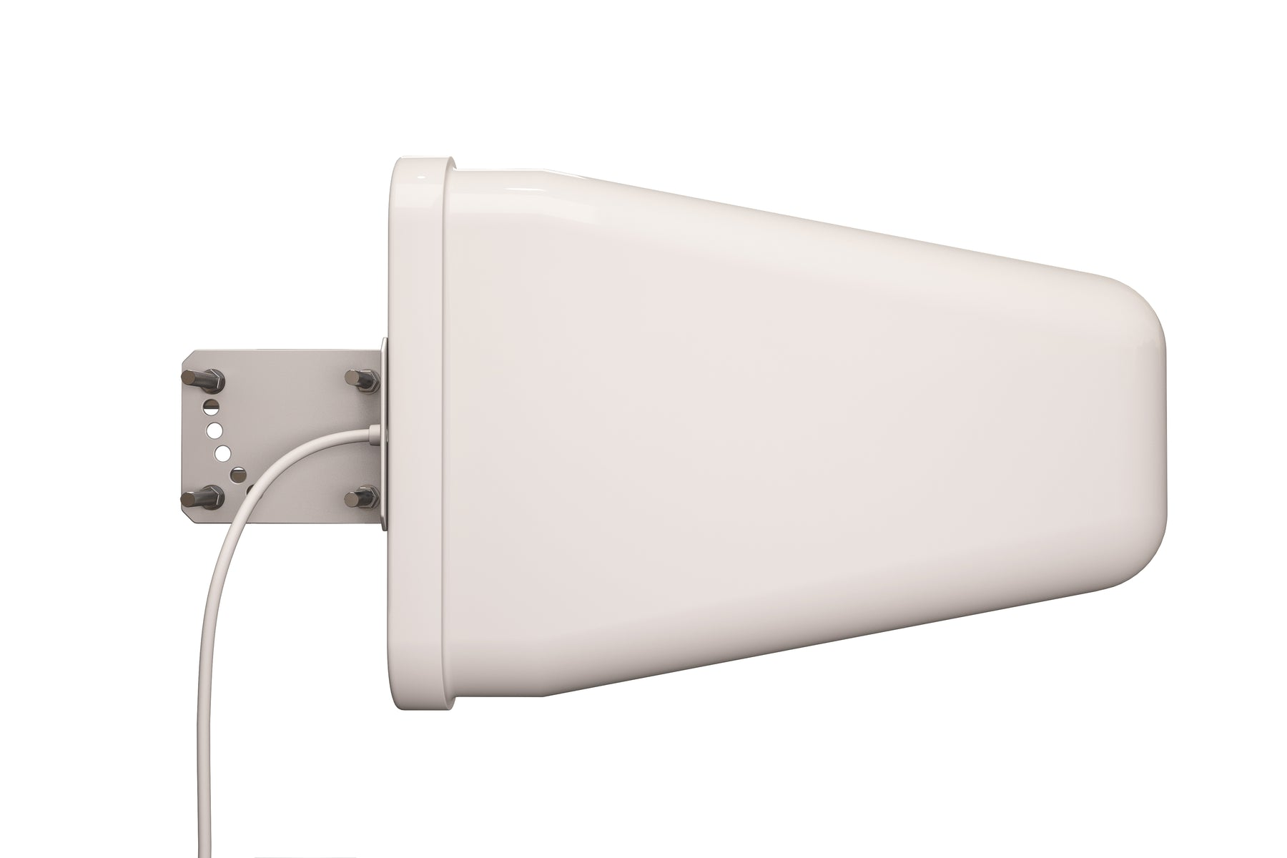
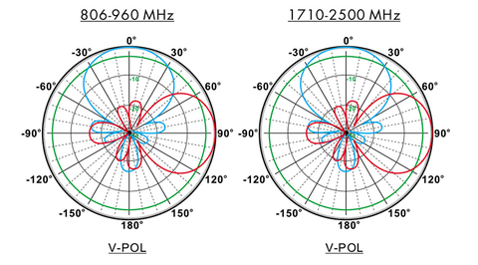
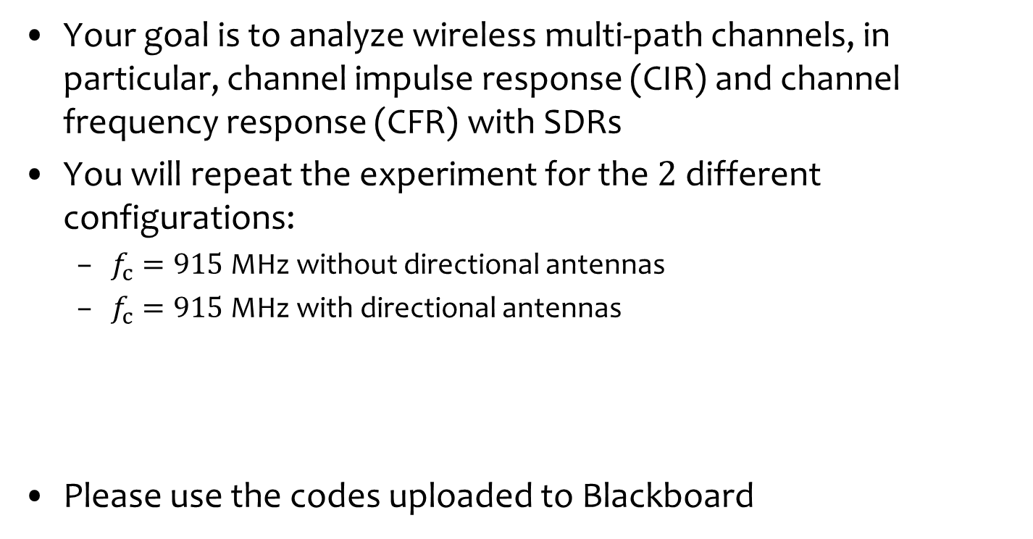
Task 1 – Multipath Channel
Your goal is to analyze wireless multi-path channels, in particular, channel impulse response (CIR) and channel frequency response (CFR) with SDRs
You will repeat the experiment for the $2$ different configurations:
$f_{c}=915$ MHz without directional antennas
$f_{c}=915$ MHz with directional antennas
Please use the codes uploaded to Blackboard
https://www.tupavco.com/products/yagi-directional-antenna-3g4glte-9dbi-800mhz-960mhz-and-17-25ghz
Please take snapshots and your notes for your justifications in your lab report

Slide 4
Part 1

Slide 5


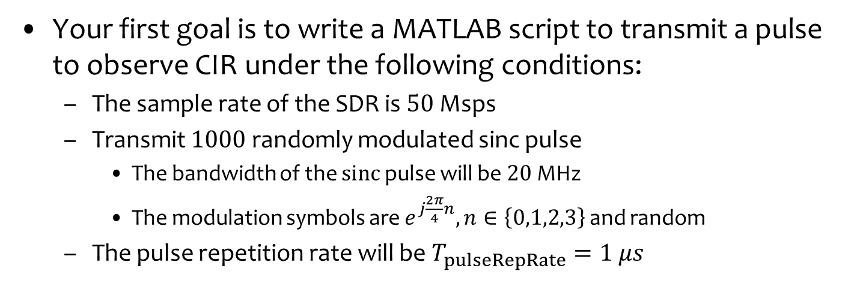



Part 1: Generating an Impulse
Your first goal is to write a MATLAB script to transmit a pulse to observe CIR under the following conditions:
The sample rate of the SDR is $50$ Msps
Transmit $1000$ randomly modulated sinc pulse
The bandwidth of the $sinc$ pulse will be $20$ MHz
The modulation symbols are $e^{j\frac{2π}{4}n},n∈\left\{0,1,2,3\right\}$ and random
The pulse repetition rate will be $T_{pulseRepRate}=1 μs$
$$p\left(t\right)=sinc\left(Bt\right)$$
Symbols
Pulse
Shape
IQ samples
SDR
Upsample
$$\{−1,1,j,j\}$$
$$T_{pulseRepRate}=1 μs$$
$$B=20 MHz$$
$f_{s}=50$ Msps

Slide 6
Part 1: Generating an Impulse
Show that the waveform in time and frequency
You can use analyzeIQdata script or your own codes
\
In the report, discuss why this waveform can be used for observing CIR and CFR

Slide 7
Part 1: Generating an Impulse
Transmit the waveform from the SDR that is connected to the Wi-Fi router (not a USB port)
Make sure that carrier frequency and the gain are set properly
% One last step common for all signals: Normalization is needed for remote
% SDRs' operation: maximum of abs(IQdataTX) should be 1 be less than 1.
if max(IQdataTX)~=0
IQdataTX = complex(IQdataTX/max(abs(IQdataTX)));
end
txPluto = sdrtx('Pluto', ...
'RadioID','ip:169.254.27.XXX', ...
'Gain', -5,...
'CenterFrequency',fc, ...
'BasebandSampleRate',fsample);
txPluto.ShowAdvancedProperties = true;
transmitRepeat(txPluto,IQdataTX)

Slide 8
Part 2

Slide 9
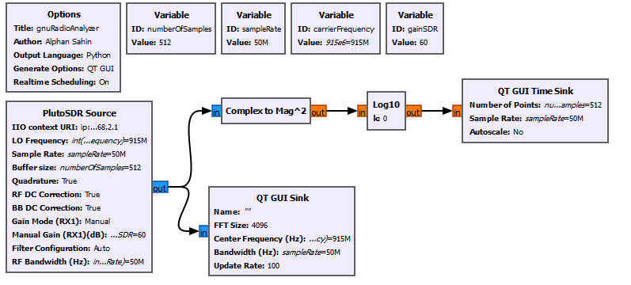
Part 2: Observing CIR and CFR
By using GNU Radio, your next goal is to create a flowgraph with the following blocks:

Slide 10
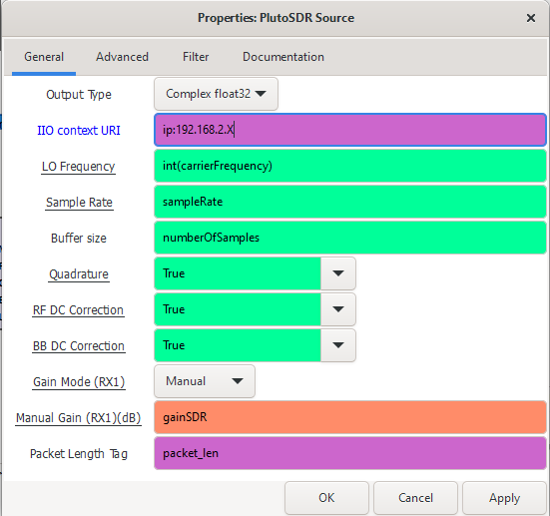
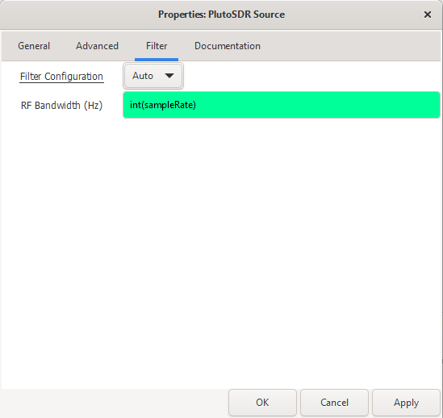
Several Settings: SDR Source
Change the IP based on your SDRs

Slide 11
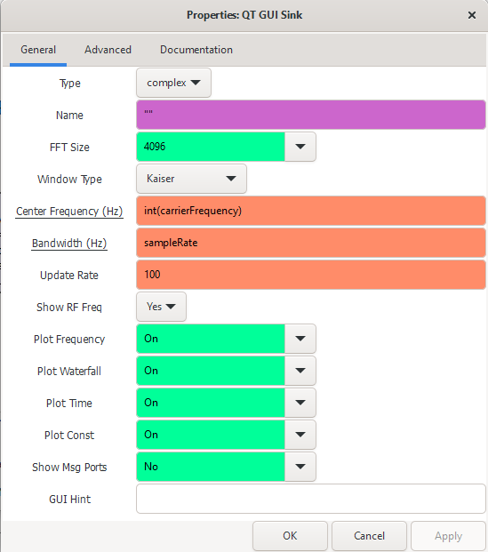
Several Settings: QT GUI Sink

Slide 12
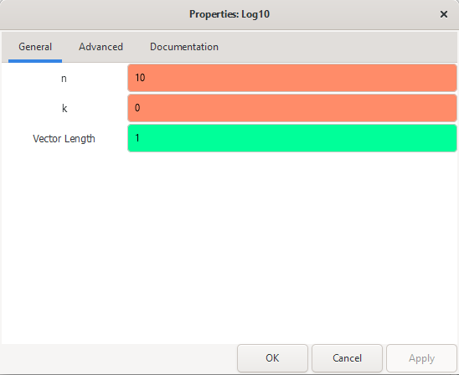

Several Settings: Log10
$$n\log_{10}\left(⋅\right)+k$$

Slide 13
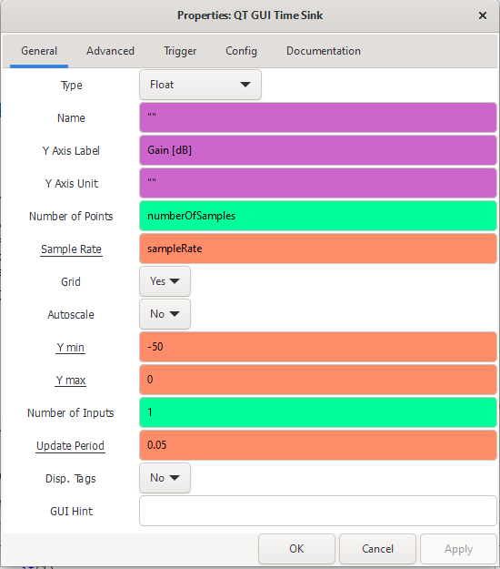
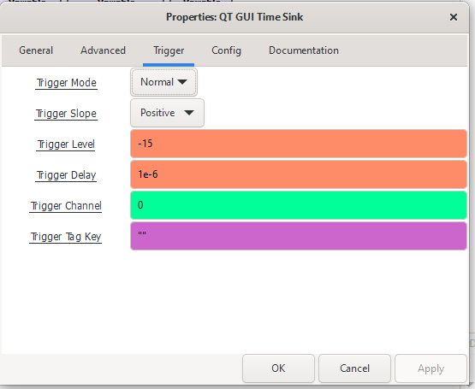
Several Settings: QT GUI Time Sink

Slide 14
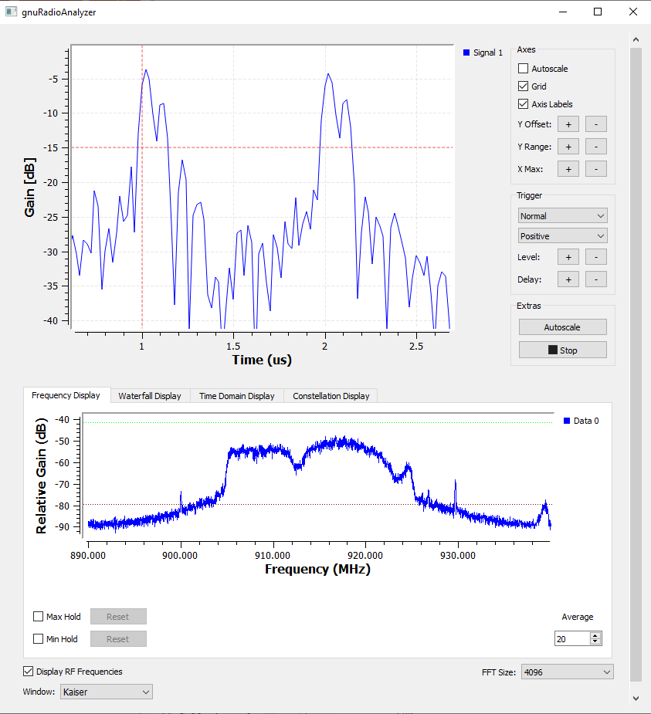
Part 2: Observing CIR and CFR
In the lab, move the TX SDR by placing it on the cart and observe the changes in CIR and CFR
When do you observe a frequency-selective fading by relating it to CIR?
Identify the conditions when the CFR is more flat
If you use the directional antenna at the transmitter, what kind of changes do you observe in the channel? Interpret
Please take snapshots and your notes for your justifications in your lab report

Slide 15
Part 3

Slide 16
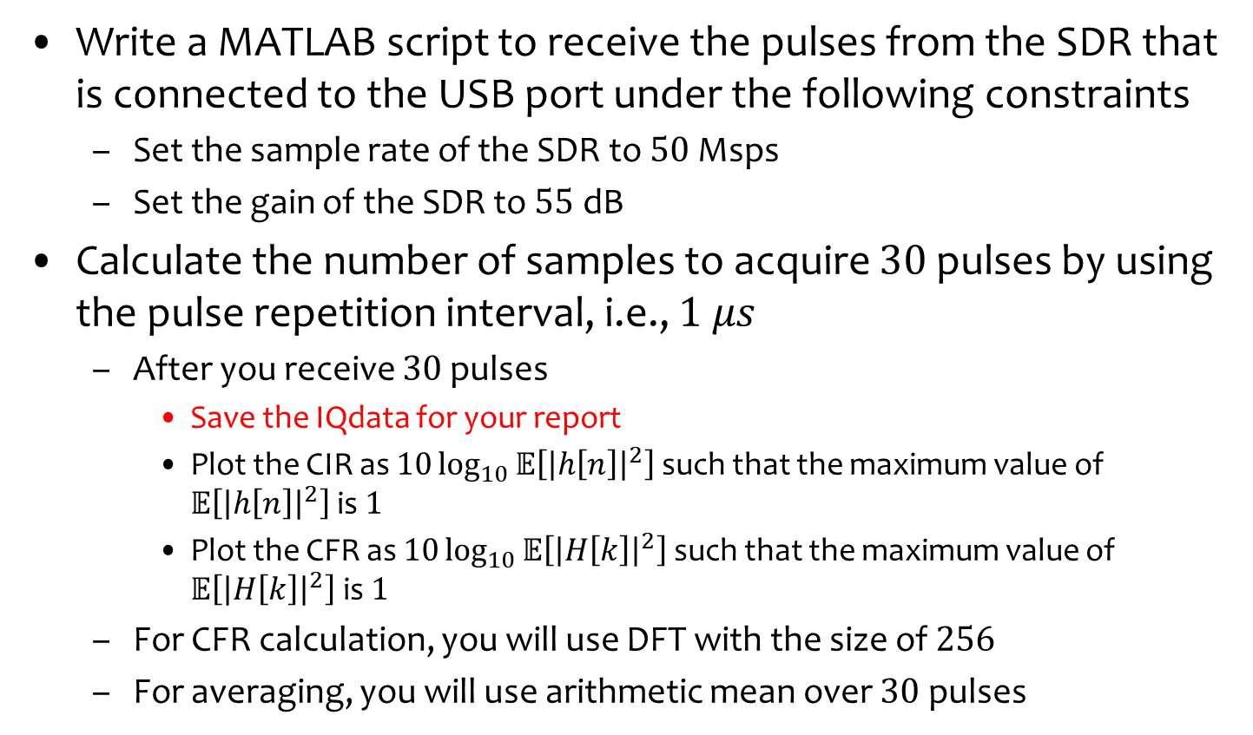
Part 3: CIR/CFR in MATLAB
Write a MATLAB script to receive the pulses from the SDR that is connected to the USB port under the following constraints
Set the sample rate of the SDR to $50$ Msps
Set the gain of the SDR to $55$ dB
Calculate the number of samples to acquire $30$ pulses by using the pulse repetition interval, i.e., $1 μs$
After you receive $30$ pulses
Save the IQdata for your report
Plot the CIR as $10\log_{10}{𝔼\left[{\left|h\left[n\right]\right|}^{2}\right]}$ such that the maximum value of $𝔼\left[{\left|h\left[n\right]\right|}^{2}\right]$ is $1$
Plot the CFR as $10\log_{10}{𝔼\left[{\left|H\left[k\right]\right|}^{2}\right]}$ such that the maximum value of $𝔼\left[{\left|H\left[k\right]\right|}^{2}\right]$ is $1$
For CFR calculation, you will use DFT with the size of $256$
For averaging, you will use arithmetic mean over $30$ pulses

Slide 17
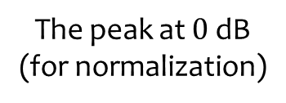
Part 3: CIR/CFR in MATLAB
Your results should look like the plots below in the end:
The peak at $0$ dB
(for normalization)
CIR
CFR
What is maximum-excess delay of the channel?

Slide 18
Part 4

Slide 19
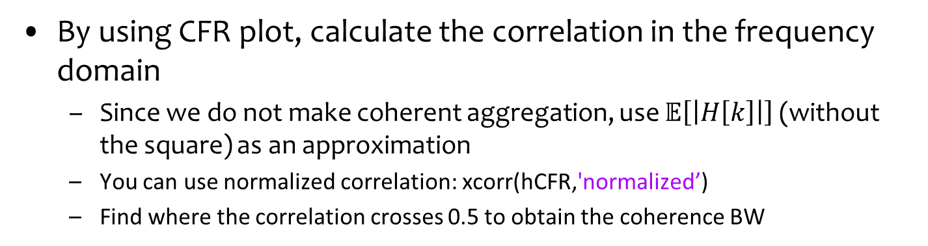
Part 4 – Measuring Coherence BW
By using CFR plot, calculate the correlation in the frequency domain
Since we do not make coherent aggregation, use $𝔼\left[\left|H\left[k\right]\right|\right]$ (without the square) as an approximation
You can use normalized correlation: xcorr(hCFR,'normalized’)
Find where the correlation crosses 0.5 to obtain the coherence BW
Please take snapshots and your notes for your justifications in your lab report

Slide 20

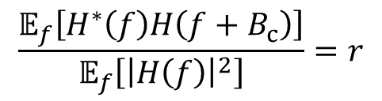

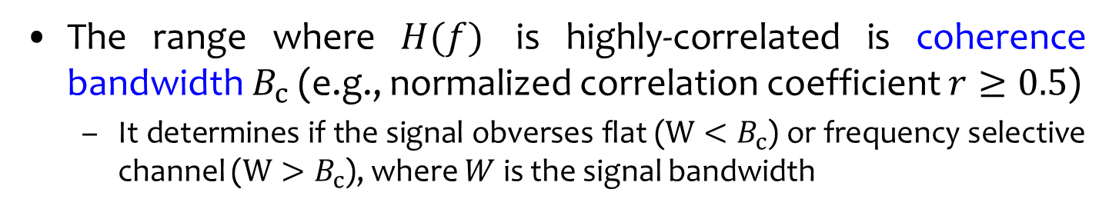


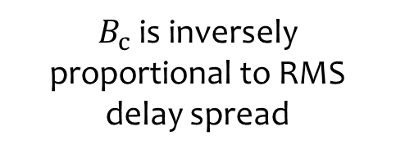
Recap: Coherence Bandwidth
The range where $H(f)$ is highly-correlated is coherence bandwidth $B_{c}$ (e.g., normalized correlation coefficient $r≥0.5$)
It determines if the signal obverses flat ($W<B_{c}$) or frequency selective channel ($W>B_{c}$), where $W$ is the signal bandwidth
$$\frac{𝔼_{f}\left[H^{∗}\left(f\right)H\left(f+B_{c}\right)\right]}{𝔼_{f}\left[{\left|H\left(f\right)\right|}^{2}\right]}{=r}$$
$B_{c}≈\frac{1}{5T_{rms}}$ for $r=0.5$
$$H\left(f+B_{c}\right)$$
$B_{c}$is inversely proportional to RMS delay spread
$$H\left(f\right)$$
$$H\left(f\right)\sim H\left(f+B_{c}\right)$$

Slide 21
Task 2 – Doppler Spread

Slide 22
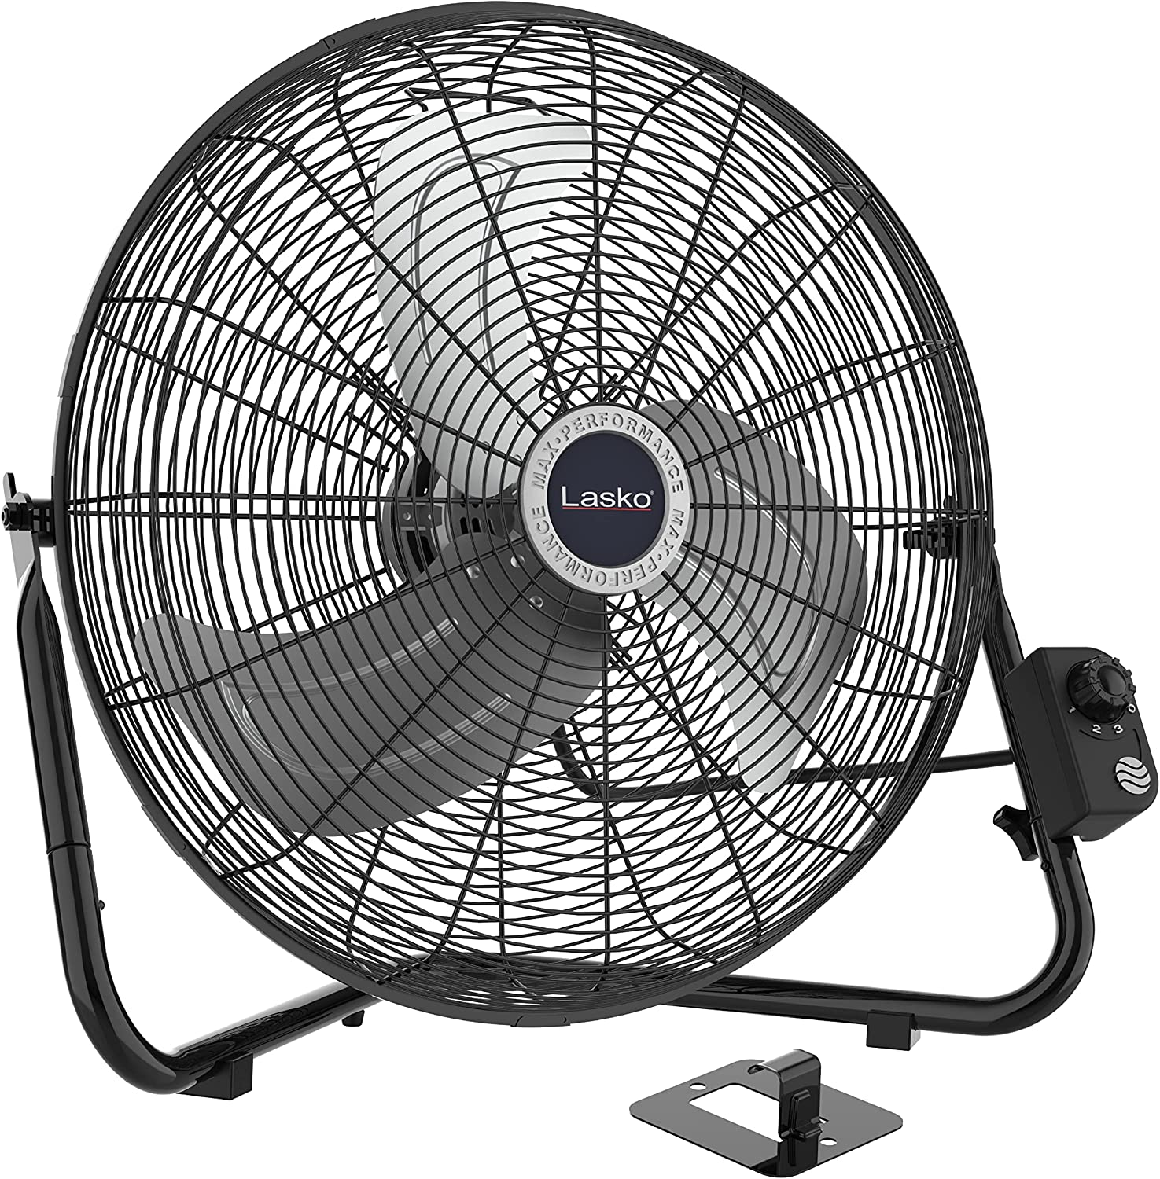
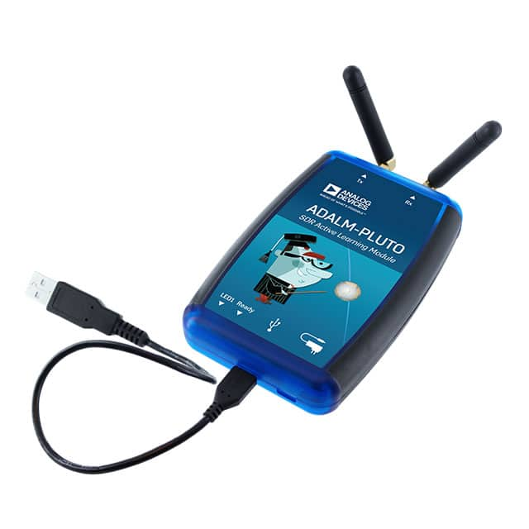
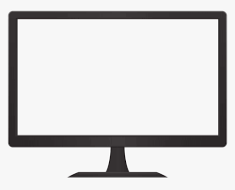
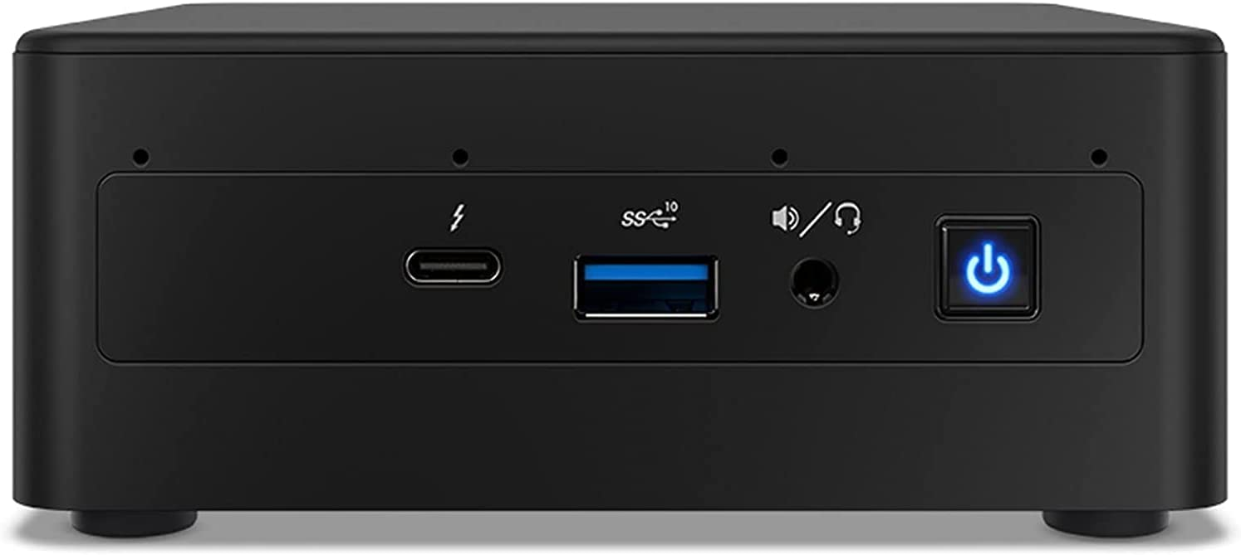
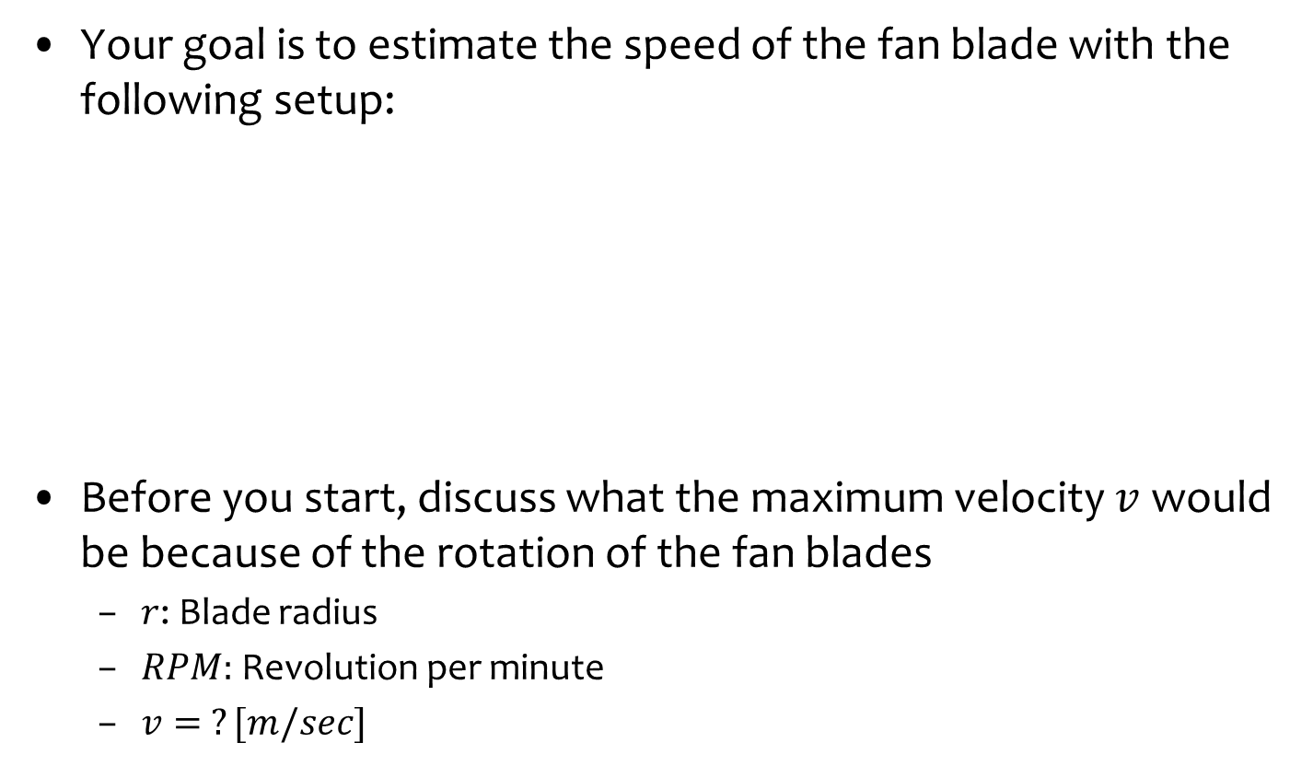

Task 2 – Doppler Spread
Your goal is to estimate the speed of the fan blade with the following setup:
Before you start, discuss what the maximum velocity $v$ would be because of the rotation of the fan blades
$r$: Blade radius
$RPM:$ Revolution per minute
$v= ?[m/sec]$
TX
RX
Doppler shift: $f_{d}=\frac{f}{c}v\cos{(θ)}$

Slide 23
Part 1

Slide 24
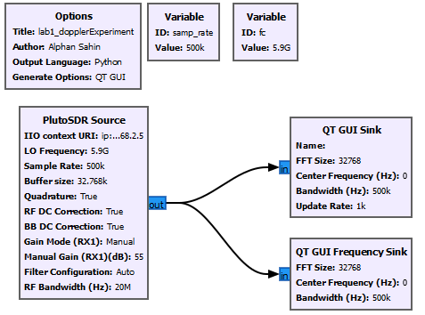
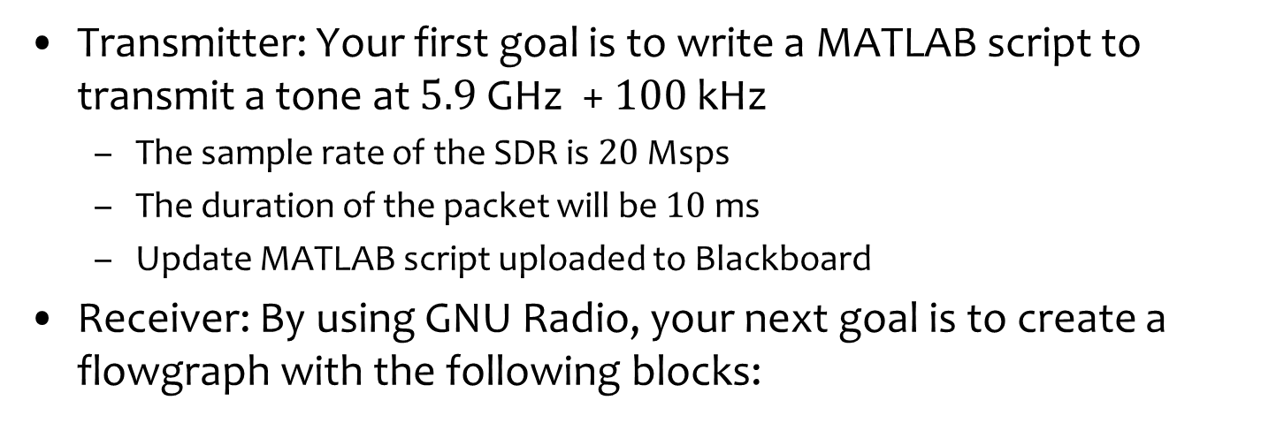
Part 1: Preparation
Transmitter: Your first goal is to write a MATLAB script to transmit a tone at $5.9$ GHz + $100$ kHz
The sample rate of the SDR is $20$ Msps
The duration of the packet will be $10$ ms
Update MATLAB script uploaded to Blackboard
Receiver: By using GNU Radio, your next goal is to create a flowgraph with the following blocks:

Slide 25
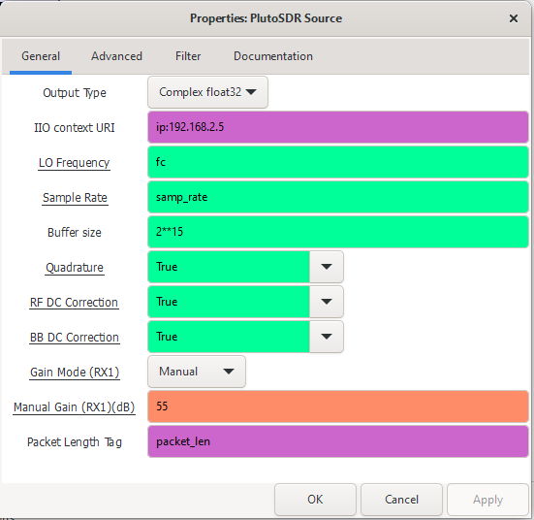
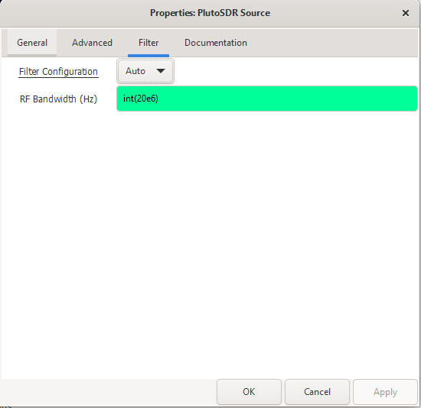
Several Settings: SDR Source
Change the IP based on your SDRs

Slide 26
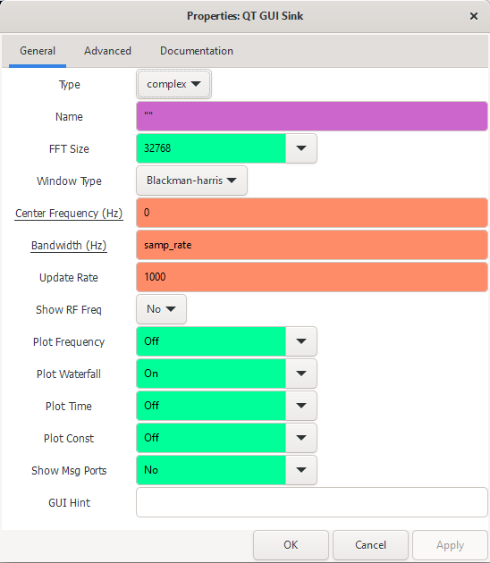
Several Settings: QT GUI Sink

Slide 27
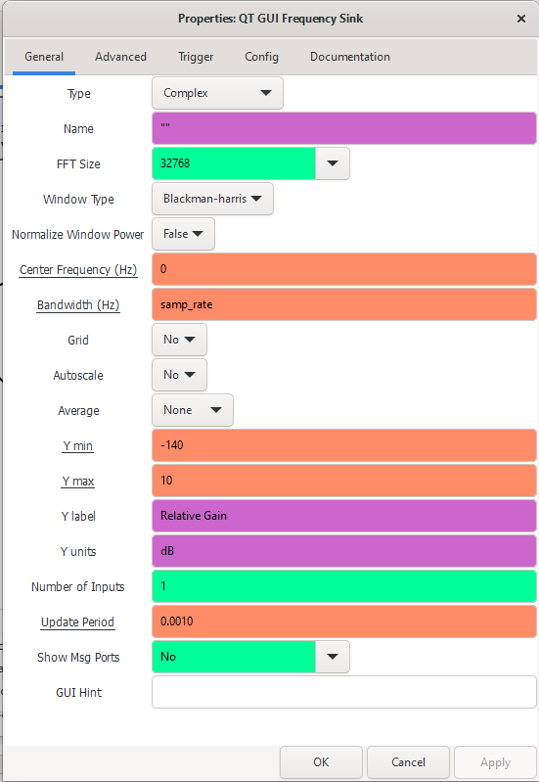
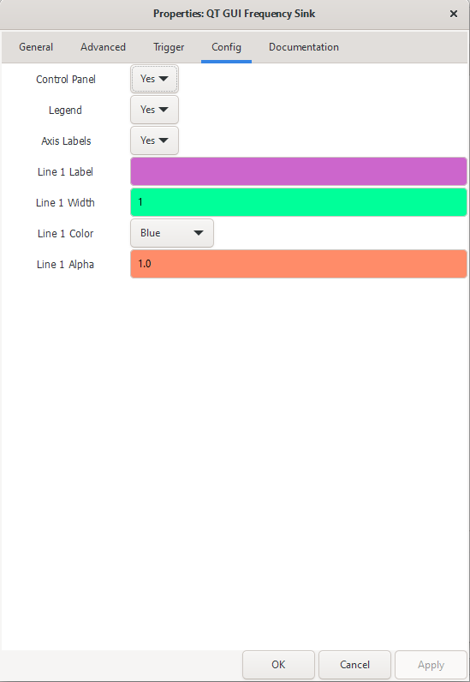
Several Settings: QT GUI Freq. Sink

Slide 28
Part 2

Slide 29
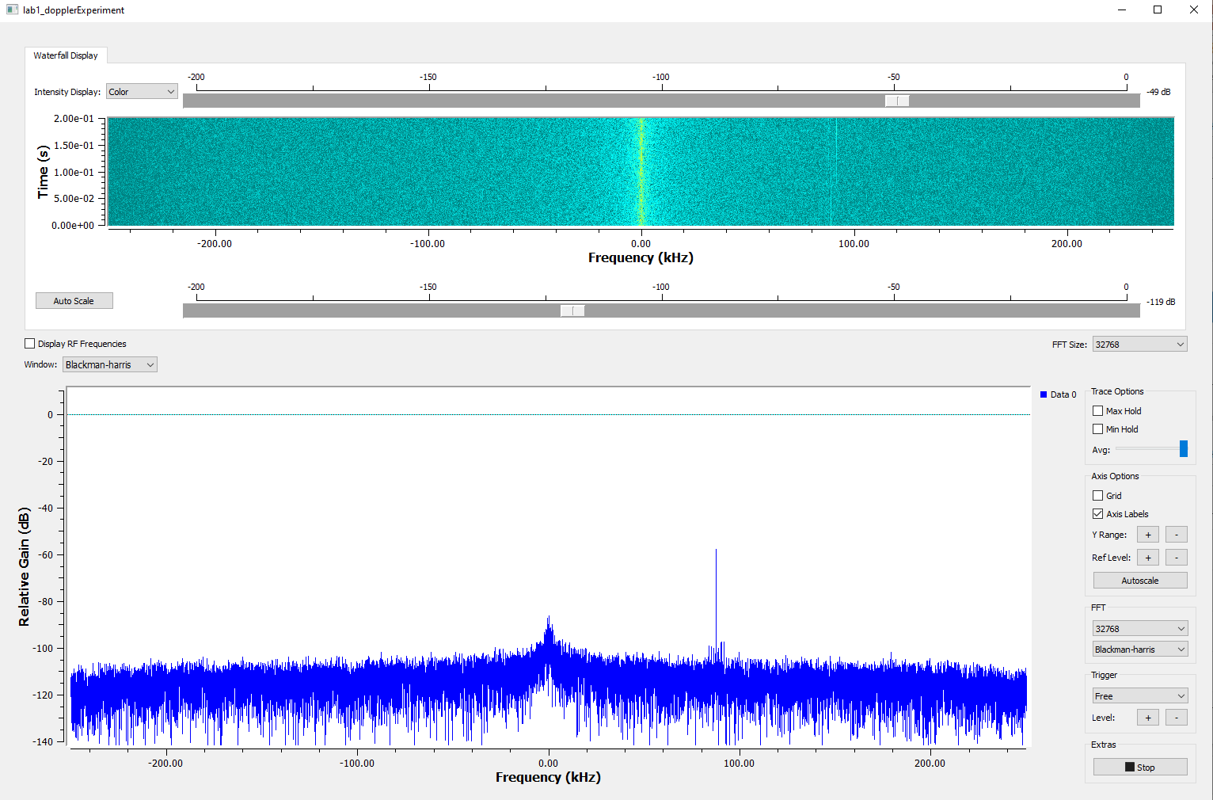
Part 2: Observing Doppler Spread
After you run both MATLAB code and flowgraph, observe the followings:
The tone transmitted

Slide 30
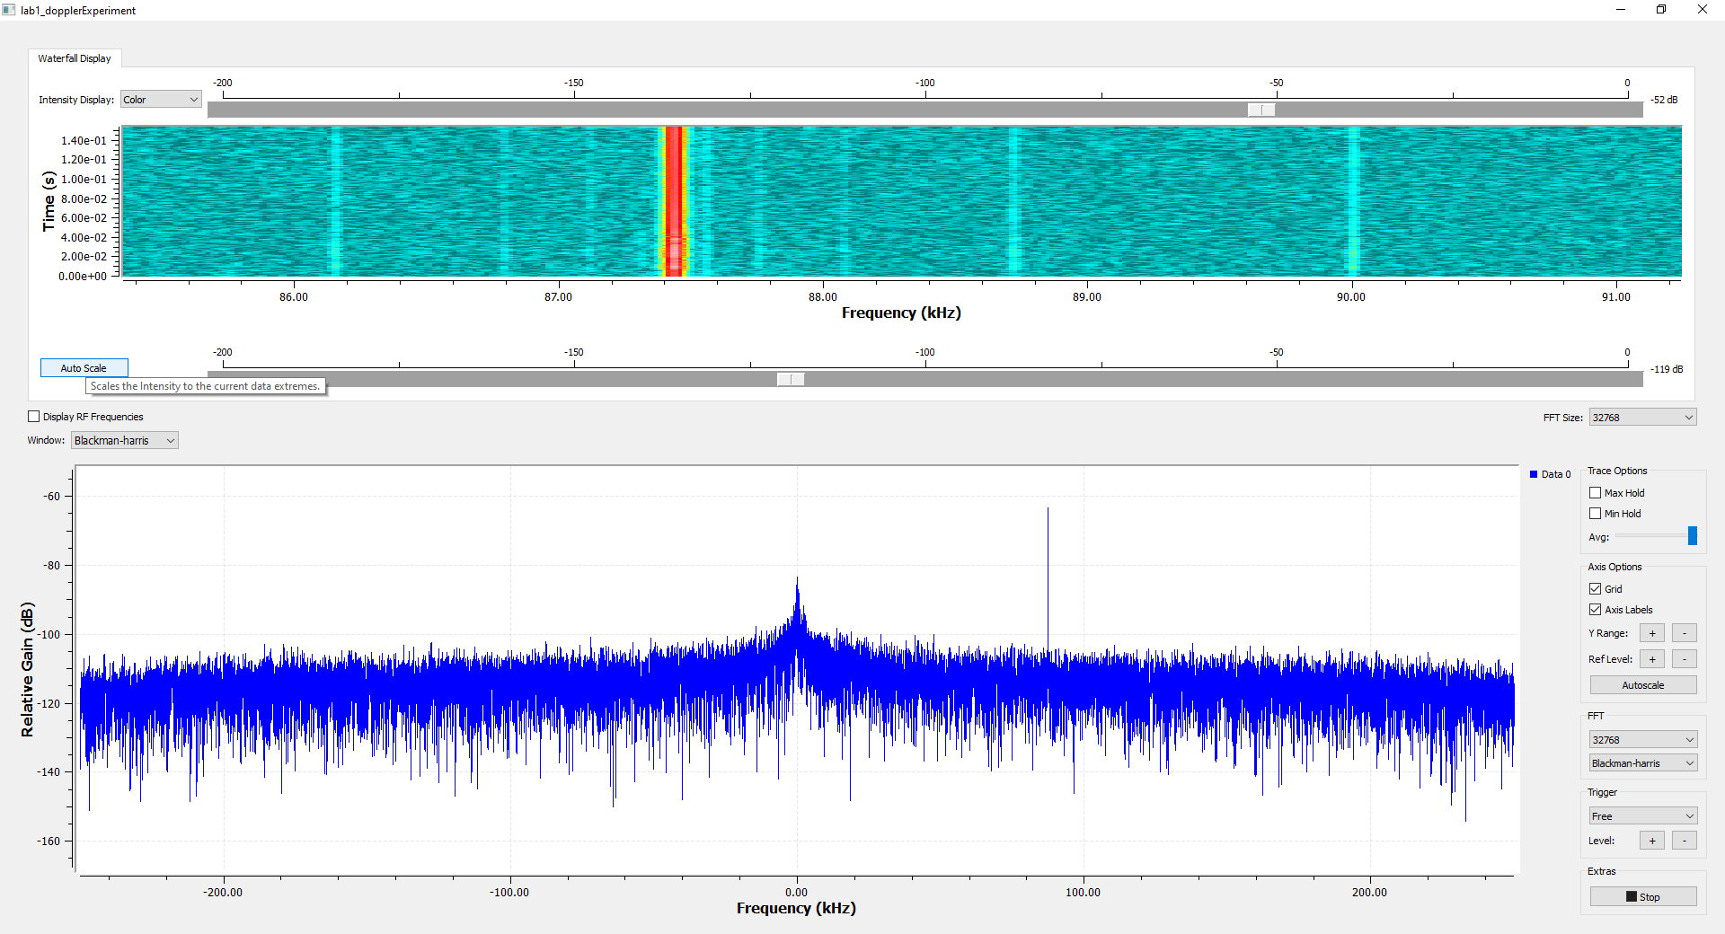
Part 2: Observing Doppler Spread
Zoom in the region where you receive the tone
Click “Auto Scale” to adjust the colors
Move your TX SDR to nearby the fan and turn-off the fan…

Slide 31
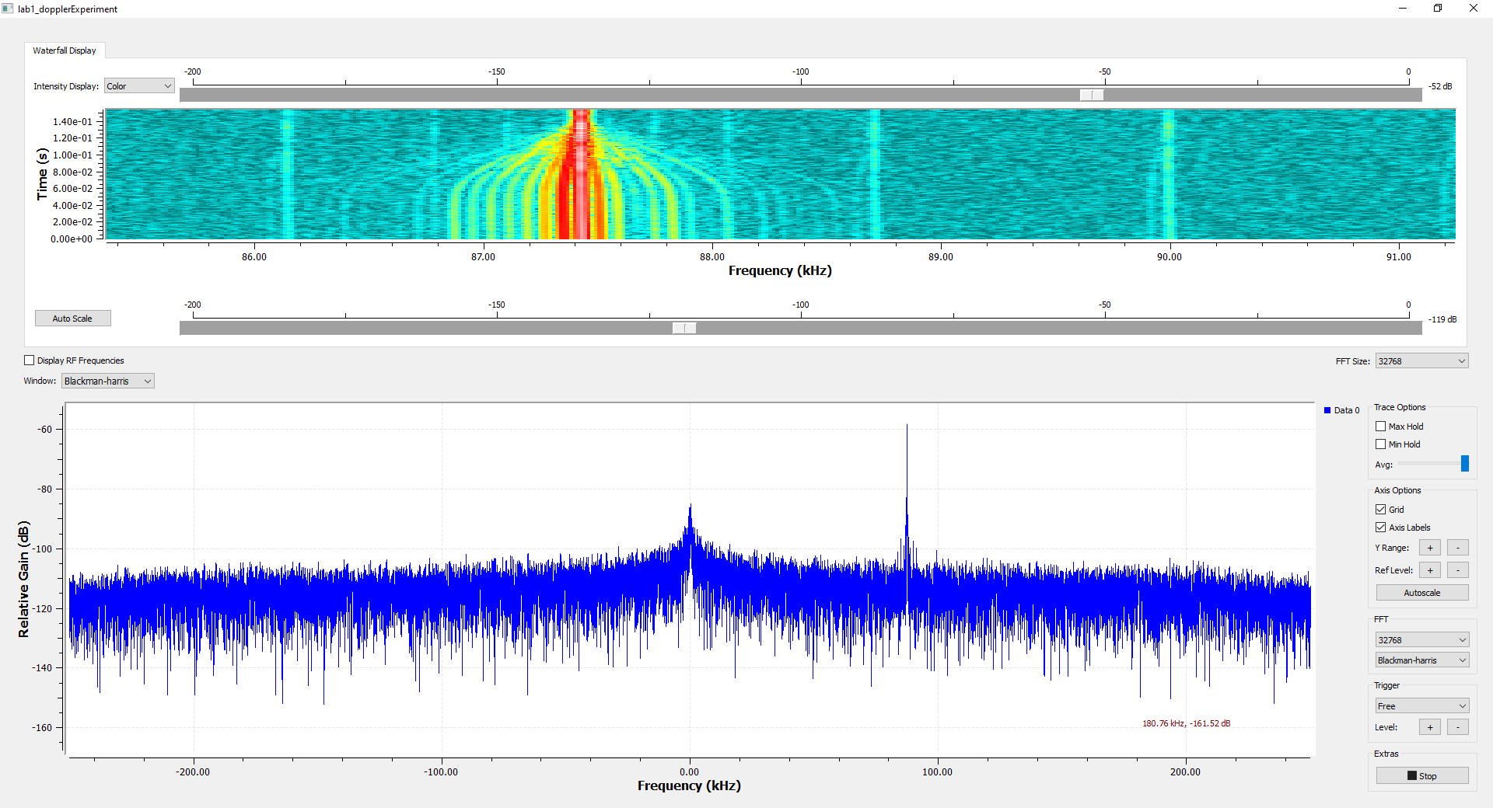

Part 2: Observing Doppler Spread
Turn on the fan at the full speed and discuss the behavior in the frequency domain
Is the spread in the frequency similar to Jake’s spectrum? Why?
What is the maximum Doppler shift?
Calculate the RPM of the fan for $r=27$ cm
For more information: https://www.ncbi.nlm.nih.gov/pmc/articles/PMC9824501/pdf/sensors-23-00038.pdf
Fan specs: https://m.media-amazon.com/images/I/C15ymxknabL.pdf

